Slide 1


POLITECNICO DI MILANO
Aerospace Control Systems - ACS
Academic year 2023-24
Group
Mina Baniamein
Camille Louis
Marco Hanna
10627453
11025467
10571718
Group: ACS A.A. 20223/2024

Slide 2
Model Description

Slide 3
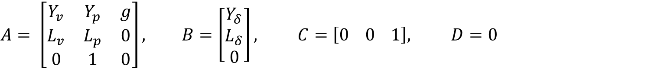
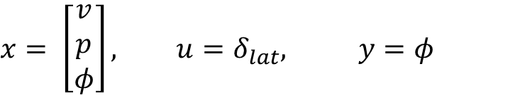
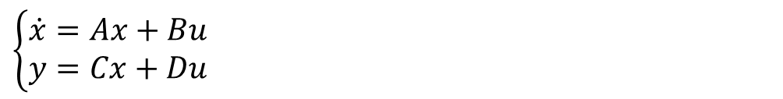
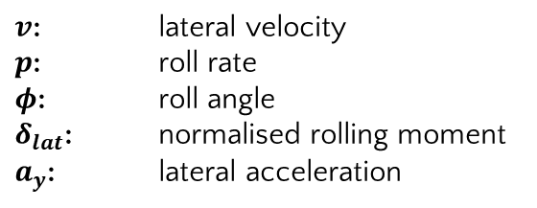
MODEL DESCRIPTION
The state space representation of the linearized later dynamics is given by:
$$\left\{\begin{aligned}\dot{x}=Ax+Bu \\ y=Cx+Du\end{aligned}\right.$$
$$A= \left[\begin{matrix}Y_{v} & Y_{p} & g \\ L_{v} & L_{p} & 0 \\ 0 & 1 & 0\end{matrix}\right], B=\left[\begin{matrix}Y_{δ} \\ L_{δ} \\ 0\end{matrix}\right], C=\left[0 0 1\right], D=0$$
$$x= \left[\begin{matrix}v \\ p \\ φ\end{matrix}\right], u=δ_{lat}, y=φ$$
$v$: lateral velocity
$p$: roll rate
$φ$: roll angle
$δ_{lat}$: normalised rolling moment
$a_{y}$: lateral acceleration

Slide 4
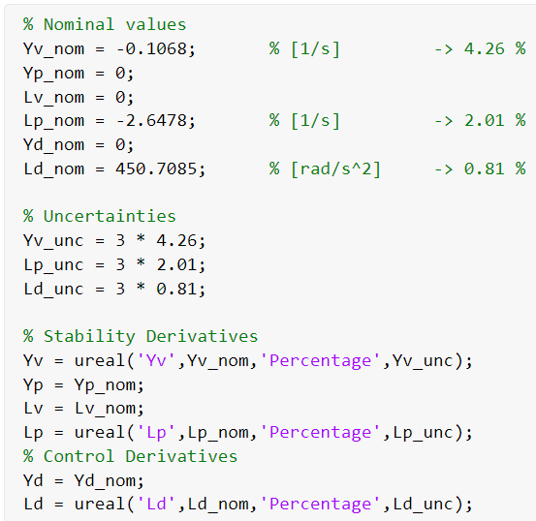
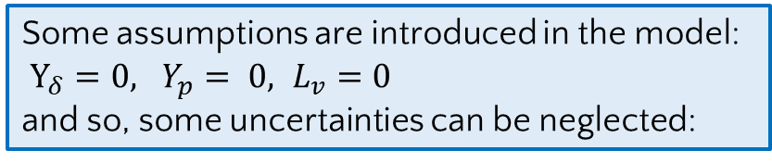
MODEL DESCRIPTION
Some assumptions are introduced in the model:
$Y_{δ}=0, Y_{p}= 0, L_{v}=0$
and so, some uncertainties can be neglected:
Group: PSD ACS A.A. 2022/2023

Slide 5
Task 1

Slide 6
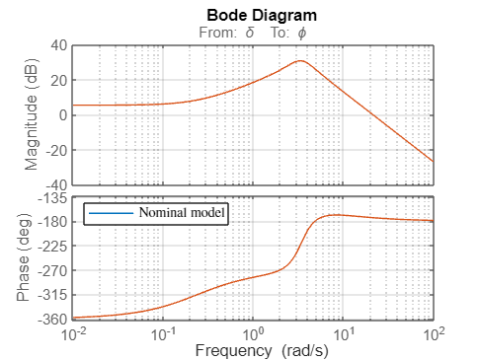
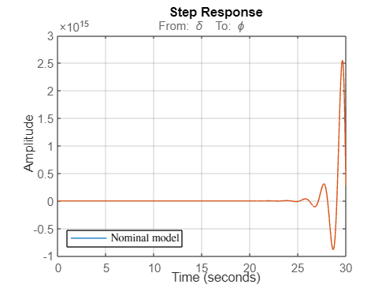

TASK 1 for nominal system
Poles | Zeros
-4.9479 | -0,2416
1.0967+3.2626i
1.0967-3.2626i
δ
Φ
$$\frac{450,7s+108,9}{s^{3}+2,755s^{2}+0,9951s+58,62}$$
pitching moment
roll angle
Unstable
Group: ACS A.A. 2023/2024

Slide 7
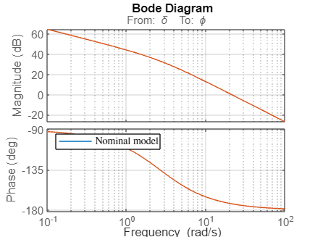
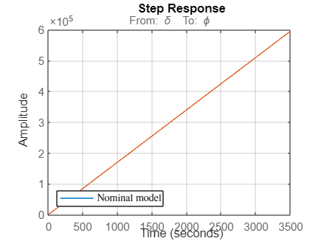


TASK 1 considering simplifying assumptions
Poles | Zeros
0
-2,6478
δ
Φ
$$\frac{450,7}{s^{2}+2,648s}$$
${\text{Φ}\text{(}\text{t}\text{)}=K(1−e}^{−2,648t}$)+Ct
Group: ACS A.A. 2023/2024

Slide 8
Task 2

Slide 9
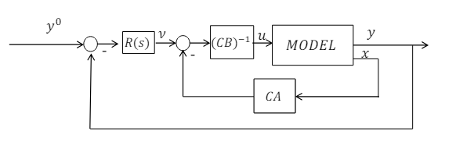
TASK 2: DYNAMIC INVERSION LOOP DESIGN
Design a DI loop using the simplified model and nominal values for the parameters
Dynamic inversion characteristics:
Aim: Used in aerospace and robotics for precise and responsive control of complex systems.
Technique: Involves inverting the system's dynamics.
Linearity: Omits the system's nonlinearities, standardizing the dynamics
Simplification: makes system easier to control with traditional linear methods.
Improved Performance: Enhances controller action and effectiveness.
Group: ACS A.A. 2023/2024

Slide 10
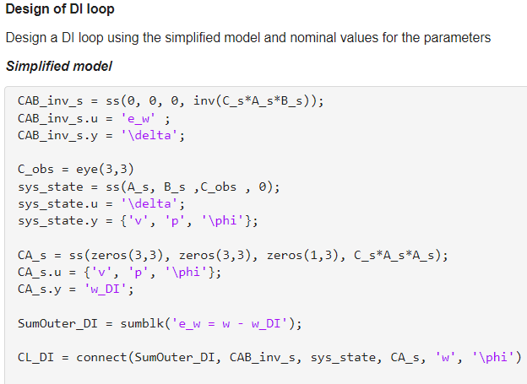
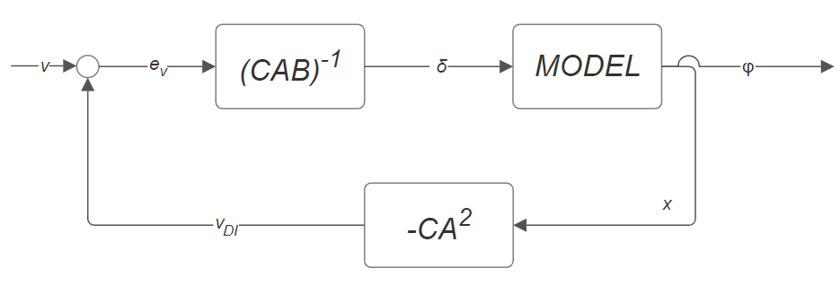
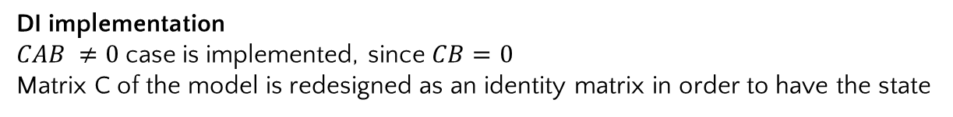
TASK 2: DYNAMIC INVERSION LOOP DESIGN
DI implementation
$CAB ≠0$case is implemented, since $CB=0$
Matrix C of the model is redesigned as an identity matrix in order to have the state
Group: ACS A.A. 2023/2024

Slide 11

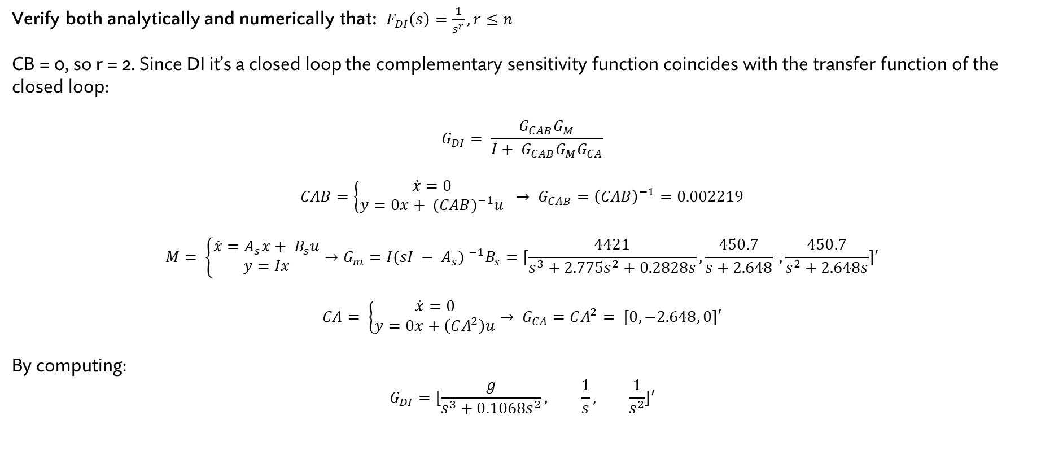
TASK 2: DI LOOP DESIGN
Verify both analytically and numerically that: $F_{DI}\left(s\right)=\frac{1}{s^{r}}, r≤n$
CB = 0, so r = 2. Since DI it’s a closed loop the complementary sensitivity function coincides with the transfer function of the closed loop:
$$G_{DI}= \frac{G_{CAB}G_{M}}{I+ G_{CAB}G_{M}G_{CA}}$$
$$CAB=\left\{\begin{aligned}\dot{x}=0 \\ y=0x+ {(CAB)}^{−1}u\end{aligned} → G_{CAB}={\left(CAB\right)}^{−1}=0.002219\right.$$
$$M= \left\{\begin{aligned}\dot{x}=A_{s}x+ B_{s}u \\ y=Ix\end{aligned}\right.→G_{m}=I{(sI − A_{s}) }^{−1}B_{s}=[\frac{4421}{s^{3}+{2.775s}^{2}+0.2828s}, \frac{450.7}{s+2.648} , \frac{450.7}{s^{2}+2.648s}]′$$
$$CA= \left\{\begin{aligned}\dot{x}=0 \\ y=0x+\left(CA^{2}\right)u\end{aligned}→ G_{CA}=CA^{2}= [0, −2.648, 0]′\right.$$
By computing:
$$G_{DI}=[\frac{g}{s^{3}+0.1068s^{2}}, \frac{1}{s}, \frac{1}{s^{2}}]′$$
$F_{DI}$of the y response φ
Group: ACS A.A. 2023/2024

Slide 12
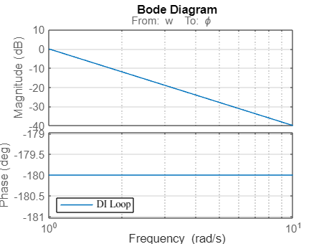
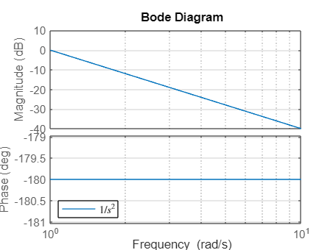

TASK 2: DI LOOP DESIGN
Numerical verification
Dynamic inversion
$$\frac{1}{s^{2}}$$
Group: ACS A.A. 2023/2024

Slide 13
Task 3

Slide 14
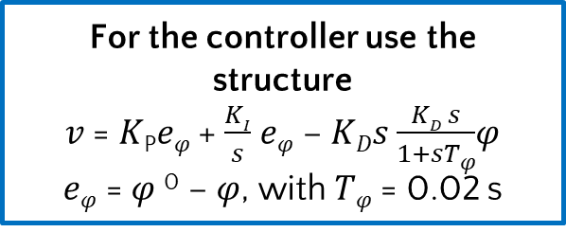
TASK 3: Design of the controller
Mixed sensitivity synthesis:
To impose requirement in order to obtain controllers
Design approach:
For the controller use the structure
𝑣 = 𝐾_{P}𝑒_{𝜑} + $\frac{KI}{s}$ 𝑒_{𝜑} − 𝐾_{𝐷}𝑠 $\frac{KD s}{1+sT\text{φ}}$𝜑
𝑒_{𝜑} = 𝜑 ⁰ − 𝜑, with 𝑇_{𝜑} = 0.02 s
Nominal Performance: Response of 𝜑 to variations in 𝜑⁰ : equivalent to a second order response with 𝜔_{n} ≥ 10 𝑟𝑎𝑑/𝑠 and 𝜉 ≥ 0.9.
Control effort limitation: |𝛿_{𝑙𝑎𝑡}| ≤ 0.05 for the doublet change in 𝜑⁰ (with 10 π/180 rad amplitude) given by (in deg)
Group: ACS A.A. 2023/2024

Slide 15
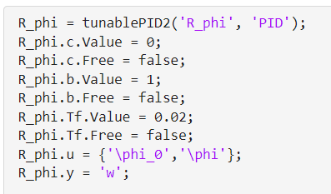
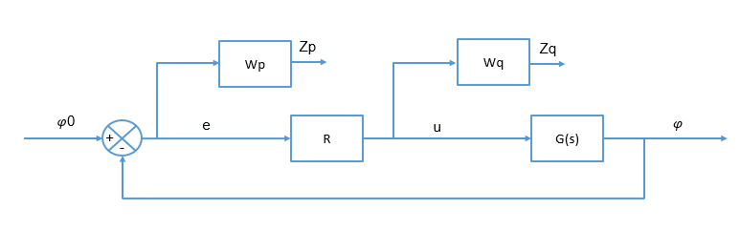
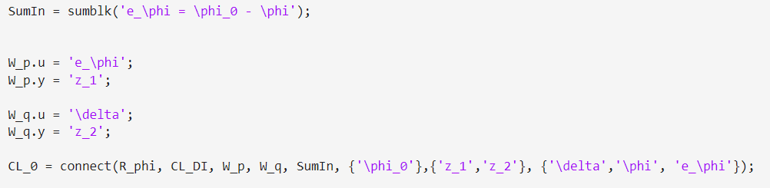
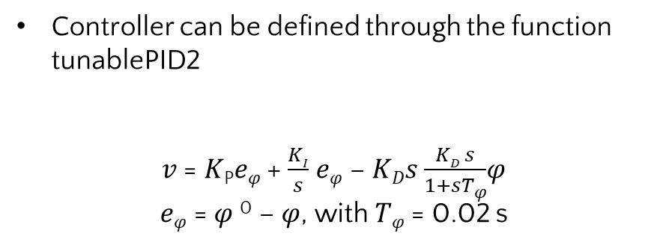
TASK 3: Design of the controller
Controller can be defined through the function tunablePID2
𝑣 = 𝐾_{P}𝑒_{𝜑} + $\frac{KI}{s}$ 𝑒_{𝜑} − 𝐾_{𝐷}𝑠 $\frac{KD s}{1+sT\text{φ}}$𝜑
𝑒_{𝜑} = 𝜑 ⁰ − 𝜑, with 𝑇_{𝜑} = 0.02 s
2 inputs
Where do we put the controller in our system?
Group: ACS A.A. 2023/2024

Slide 16
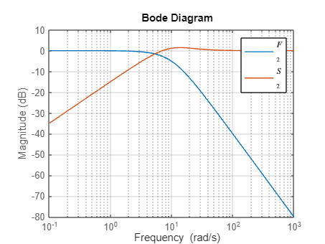
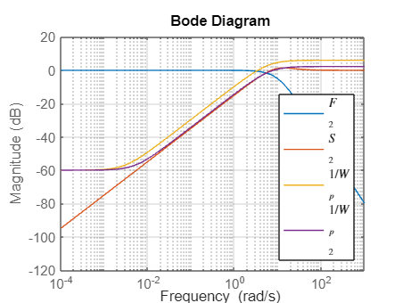
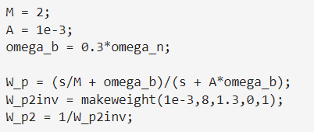
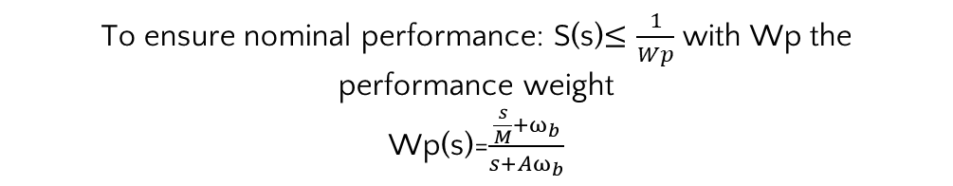

TASK 3: Design of the controler
Nominal Performance: Response of 𝜑 to variations in 𝜑 ⁰ : equivalent to a second order response with 𝜔_{𝑛} ≥ 10 𝑟𝑎𝑑/𝑠 and 𝜉 ≥ 0.9.
F(s) = $\frac{\text{φ}}{\text{φ}o}$ = $\frac{ω_{n}^{2}}{\begin{aligned}s^{2}+2\text{ξ}ωn+ωn^{2} \\ \end{aligned}}$ => S(s)=1-F(s)
When $ω_{n}$ and $\text{ξ}$ are equal to specific limiting values:
$$\text{ξ}\text{=0,9 }\text{and} wn=10 {rad}/s$$
To ensure nominal performance: S(s)$≤\frac{1}{Wp}$ with Wp the performance weight
Wp(s)=$\frac{\frac{s}{M}+ω_{b}}{s+Aω_{b}}$
Performance weight parameters:
M= Related to the peak amplitude of S(s)
A= Related to the high frequency magnitude
Wb= Related to the cross-over frequency
Group: ACS A.A. 2023/2024

Slide 17

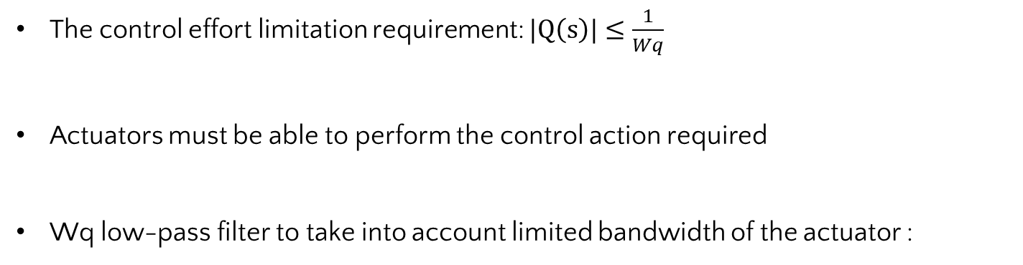
TASK 3: Design of the controller
Control effort limitation: |𝛿_{𝑙𝑎𝑡}| ≤ 0.05 for the doublet change in 𝜑 0 (with 10 π/180 rad amplitude) given by (in deg)
The control effort limitation requirement: $|Q\left(s\right)|≤\frac{1}{Wq}$
Actuators must be able to perform the control action required
Wq low-pass filter to take into account limited bandwidth of the actuator :
W_{act}: Actuator frequency
α: High frequency gain
Group: ACS A.A. 2023/2024

Slide 18

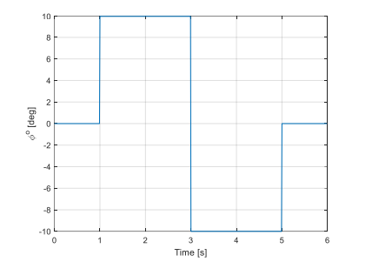
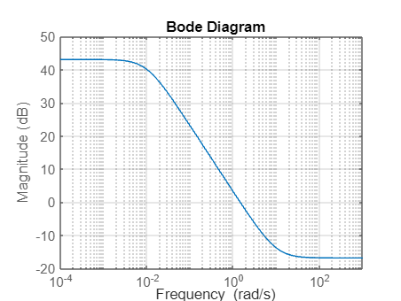

TASK 3: Design of the controller
Since most of the control effort is expected at the beginning of the transient response, the initial value theorem can me applied:
Control weight parameters:
$ω_{τ}$ =10rad/s
α =6,981 rad
20°
Step of 20° magnitude
Group: ACS A.A. 2023/2024

Slide 19
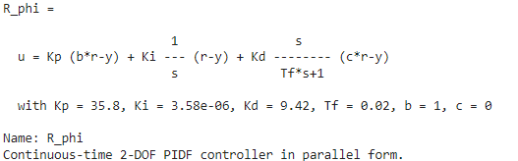


TASK 3: Design of the controller
For the controller use the structure (MATLAB tunablePID2):
𝑣 = 𝐾_{P}𝑒_{𝜑} + $\frac{KI}{s}$ 𝑒_{𝜑} − 𝐾_{𝐷}𝑠 $\frac{KD s}{1+sT\text{φ}}$𝜑
𝑒_{𝜑} = 𝜑 ⁰ − 𝜑, with 𝑇_{𝜑} = 0.02 s
This function optimizes controller parameters to minimize the closed-loop H∞ norm
Regulator has high Kp, wich means fast response to the errors
Group: ACS A.A. 2023/2024

Slide 20
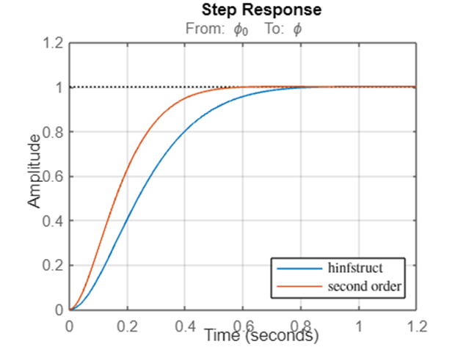
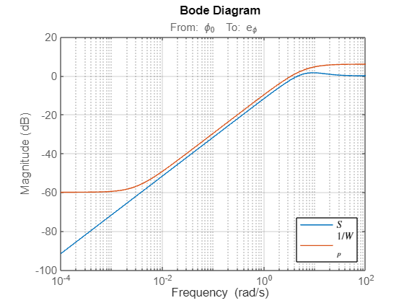
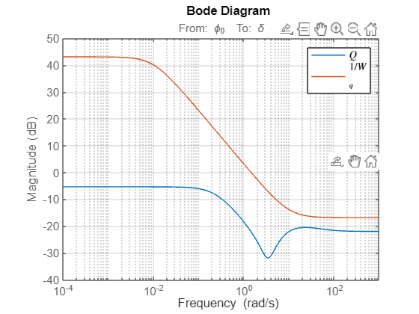
TASK 3: Design of the controller
System with no assumptions analysis
Group: ACS A.A. 2023/2024

Slide 21
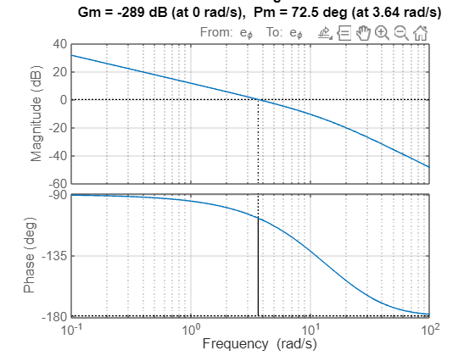
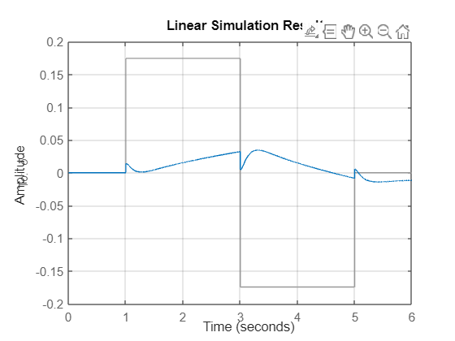
TASK 3: Design of the controller
Group: ACS A.A. 2023/2024

Slide 22
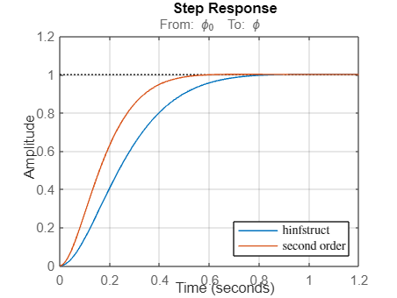
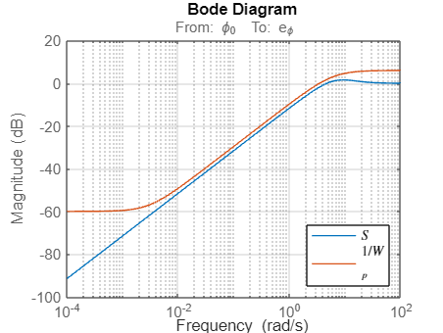
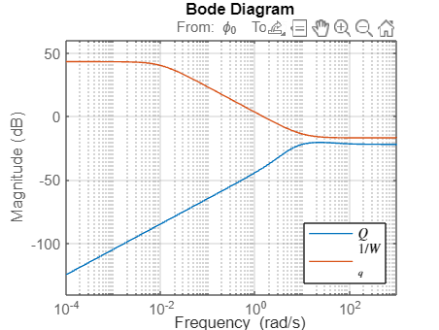

TASK 3: Design of the controller
System with assumptions analysis
Group: ACS A.A. 2023/2024

Slide 23
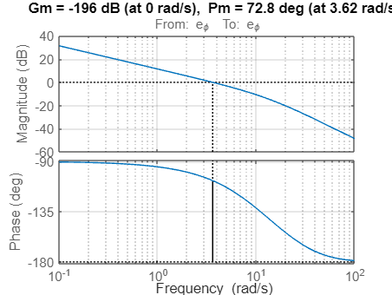
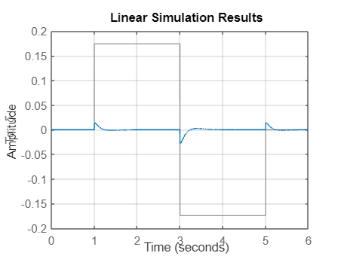
TASK 3: Design of the controller
Group: ACS A.A. 2023/2024

Slide 24
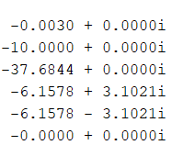
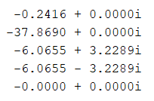
TASK 3: Design of the controller
Poles analysis
Simplified system
No assumptions
Both the systems are now asymptotically stable in nominal conditions
Group: ACS A.A. 2023/2024

Slide 25
Task 4

Slide 26
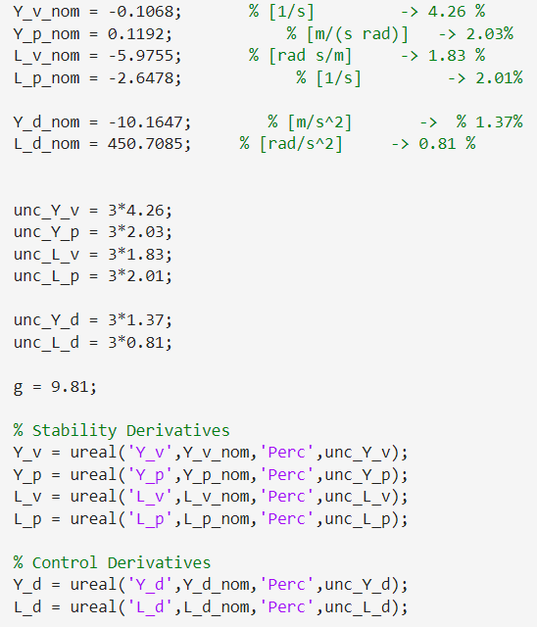


TASK 4 Uncertain modelling
To include uncertainty to the nominal model
Group: ACS A.A. 2023/2024

Slide 27
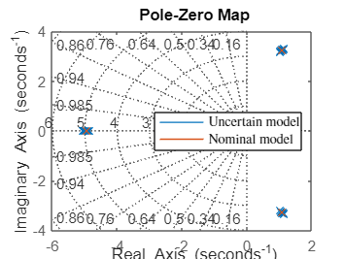
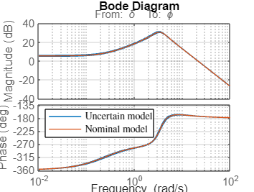
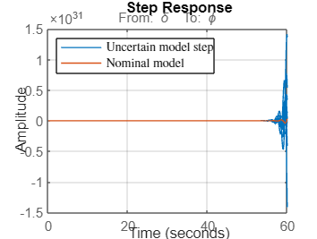
TASK 4 Uncertain modelling
Group: ACS A.A. 2023/2024

Slide 28
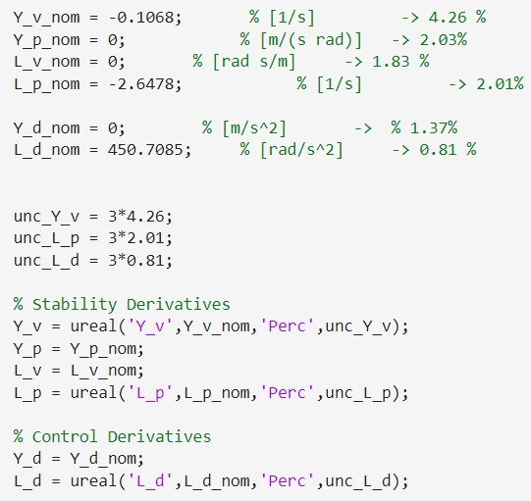
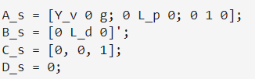

TASK4
To include uncertainty inside the linearized model
Group: ACS A.A. 2023/2024

Slide 29



TASK 4 Uncertain modelling
Group: ACS A.A. 2023/2024

Slide 30
Task 5

Slide 31


TASK 5: Robust stability analysis
Simplified system
SISO RS condition:
“For the uncertain feedback system with scalar and AS stable M(s) and Δ (s) such that |Δ|<1 ∀ω, robust stability holds if and only if: |M|<1 ∀ω”
P
Nominal part of the system
Δ
Uncertainty
To decompose the system in 2 parts we use:
Group: ACS A.A. 2023/2024

Slide 32
TASK 5: Robustness analysis
R
P
Nominal part of the system
Adding control to the system
δ
-
Φ
P
Nominal part of the system
Δ
Uncertainty
w
z
M
Δ
Uncertainty
Group: ACS A.A. 2023/2024

Slide 33







TASK 5: Robustness analysis
|Δ| analysys with no assumptions: Δ has all elements on diagonal
Group: ACS A.A. 2023/2024

Slide 34




TASK 5: Robustness analysis
|M| analysis
This result means that the system can withstand about 100% more uncertainty than is specified in the uncertain elements without going unstable.
Group: ACS A.A. 2023/2024

Slide 35




TASK 5: Robustness analysis
|Δ| analysis on simplified system: Δ has all elements on diagonal
Group: ACS A.A. 2023/2024

Slide 36

TASK 5: Robustness analysis
|M| analysis
Group: ACS A.A. 2023/2024

Slide 37
Task 6

Slide 38

TASK 6 Robust performance analysis
Analized by defining weight W on sampled uncertainties:
Robust performance is obtained if and only if :
Group: ACS A.A. 2023/2024

Slide 39


TASK 6 Robust performance analysis
Complete Model
Simplified Model
Group: ACS A.A. 2023/2024

Slide 40
Task 7

Slide 41


TASK 7 Monte Carlo validation
For cycle with sampled values that computes poles and step response characteristics of the complete system
Group: ACS A.A. 2023/2024

Slide 42


TASK 7 Monte Carlo validation
Number of samples = 100
Overshoot
Settling Time
 | Set. Time | Overshoot
Nominal | 0.6650 | 0.2709
Mean | 0.6650 | 0.2709
STD | 4.336e-15 | 1.467e-13
Group: ACS A.A. 2023/2024

Slide 43


TASK 7 Monte Carlo validation
Number of samples = 100
Phase Margin
Gain Margin
 | Phase Marg | Gain Marg.
Nominal | 72.47 | -571.8
Mean | 72.47 | -571.8
STD | 1.258e-9 | 89.76
Group: ACS A.A. 2023/2024

Slide 44


TASK 7 Monte Carlo validation
Number of samples = 100
Poles
Group: ACS A.A. 2023/2024

Slide 45




TASK 7 Monte Carlo validation
Number of samples = 1000
Settling time
Overshoot
Gain margin
Phase Margin
Group: ACS A.A. 2023/2024

Slide 46

TASK 7 Monte Carlo validation
Number of samples = 1000
Poles
Group: ACS A.A. 2023/2024

Slide 47
TASK 7 Monte Carlo validation
Distribution seems to be very poor
Already have a fast convergence with 100 iterations
Possible explanation: controller design already provides an effective control without dynamic inversion
Let’s see how the controller designed acts without DI presence
Group: ACS A.A. 2023/2024

Slide 48




TASK 7 Monte Carlo validation, NO DI
Number of samples = 1000
Settling time
Overshoot
 | NO DI | DI
σ STEP | 0.0011 | 4.336e-15
σ PM | 8.28e-4 | 1.258e-9
Gain margin
Phase Margin
Group: ACS A.A. 2023/2024

Slide 49


TASK 7 Monte Carlo validation
Number of samples = 1000
Poles
Group: ACS A.A. 2023/2024

Slide 50
TASK 7: Conclusions
The designed regulator works already effectively, a possible explanation is the high Kp
With dynamic inversion implementation it works even better, because of the linearizing effect that brings. An overshoot is generated because of the faster response to errors obtained.
Pros of having only the regulator: simple architecture, good performance
Pros of having a regulator + DI: enhanced performance, faster response
Group: ACS A.A. 2023/2024

